Slide 1

Constructor

Slide 2
Constructors in Java
Is called when an instance of the object is created.
Is a special type of method which is used to initialize the object.
Rules for creating Java constructor
Constructor name must be the same as its class name
A Constructor must have no explicit return type
A Java constructor cannot be abstract, static, final

Slide 3
Types of Java constructors
Default constructor
User-Defined constructor

Slide 4
Java Default Constructor
Default constructor is used to provide the default values to the object like 0, null, etc., depending on the type.

Slide 5
Example of default constructor that displays the default values
class Student3{
int id;
String name;
void display()
{ System.out.println(id+“ "+name); }
public static void main(String args[])
{
Student3 s1=new Student3();
Student3 s2=new Student3();
s1.display();
s2.display();
} }
Output:
0 null
0 null

Slide 6
Java Parameterized Constructor
A constructor which has a specific number of parameters
Parameterized constructor is used to provide different values to the distinct objects.

Slide 7
Example of parameterized constructor
class Student4{
int id;
String name;
Student4(int i,String n){
id = i;
name = n;
}
void display() { System.out.println(id+" "+name); }
public static void main(String args[]){
Student4 s1 = new Student4(111,"Karan");
Student4 s2 = new Student4(222,"Aryan");
s1.display();
s2.display();
} }
Output:
111 Karan
222 Aryan

Slide 8
Example of Constructor Overloading
class Student5{
int id;
String name;
int age;
Student5(int i,String n){
id = i;
name = n;
}
Student5(int i,String n,int a){
id = i;
name = n;
age=a;
}
void display()
{
System.out.println(id+" "+name+" "+age);
}
public static void main(String args[]){
Student5 s1 = new Student5(111,"Karan");
Student5 s2 = new Student5(222,"Aryan",25);
s1.display();
s2.display();
}
}
Output:
111 Karan 0
222 Aryan 25

Slide 9
Difference between constructor and method in Java
Java Constructor | Java Method
A constructor is used to initialize the state of an object. | A method is used to expose the behavior of an object.
A constructor must not have a return type. | A method must have a return type.
The constructor is invoked implicitly. | The method is invoked explicitly.
The Java compiler provides a default constructor if you don't have any constructor in a class. | The method is not provided by the compiler in any case.
The constructor name must be same as the class name. | The method name may or may not be same as class name.

Slide 10
static keyword

Slide 11
static keyword
Used for memory management mainly.
A static method can be accessed without creating an object of the class first:

Slide 12
The static can be used with :
Variable (also known as a class variable)
Method (also known as a class method)
Block
Nested class

Slide 13
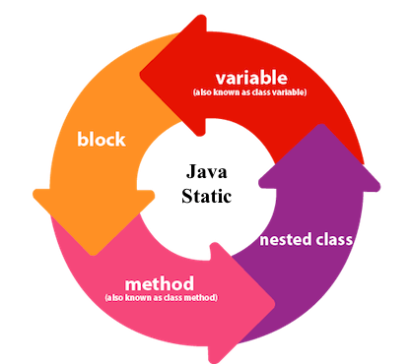

Slide 14
static variable
If we declare any variable as static, it is known as a static variable.
Used to refer to the common property of all objects (which is not unique for each object), for example, the company name of employees, college name of students, etc.
Gets memory only once in the class area at the time of class loading.

Slide 15
Advantages of static variable
Memory efficient (i.e., it saves memory).

Slide 16
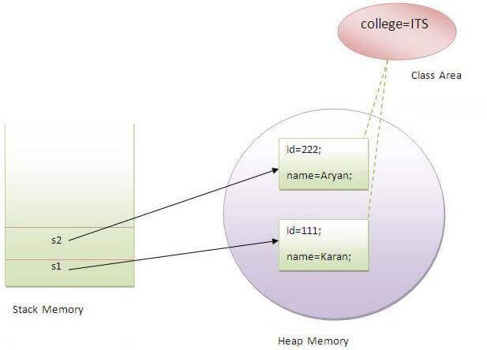

Slide 17
Java static method
If we declare any method static keyword is known as static method.
A static method belongs to the class rather than the object of a class.
A static method can be invoked without the need for creating an instance of a class.
A static method can access static data member and can change the value of it.

Slide 18
class StaticTest {
// non-static method
int multiply(int a, int b){
return a * b;
}
// static method
static int add(int a, int b){
return a + b;
}
}
public class Main {
public static void main( String[] args ) {
// create an instance of the StaticTest class
StaticTest st = new StaticTest();
// call the nonstatic method
System.out.println(" 2 * 2 = " + st.multiply(2,2));
// call the static method
System.out.println(" 2 + 3 = " + StaticTest.add(2,3));
}
}

Slide 19
Java static block
Is used to initialize the static data member.
Is executed before the main method at the time of classloading.

Slide 20
Example
class A2{
static{
System.out.println("static block is invoked");
}
public static void main(String args[]){
System.out.println("Hello main");
}
}

Slide 21
Static class
A class can be made static only if it is a nested class.
Nested static class doesn’t need reference of Outer class
A static class cannot access non-static members of the Outer class

Slide 22
class JavaExample{
private static String str = “Cranberrys";
static class MyNestedClass{
public void disp() {
System.out.println(str);
}
}
public static void main(String args[])
{ JavaExample.MyNestedClass obj = new JavaExample.MyNestedClass();
obj.disp();
}
}

Slide 23
this keyword in java

Slide 24
this keyword
this is a reference variable that refers to the current object.
this keyword is to eliminate the confusion between class attributes and parameters with the same name

Slide 25
Usage of Java this keyword
this can be used to refer current class instance variable.
this can be used to invoke current class method (implicitly)
this() can be used to invoke current class constructor.

Slide 26
this: to refer current class instance variable
this keyword can be used to refer current class instance variable.
If there is ambiguity between the instance variables and parameters, this keyword resolves the problem of ambiguity.

Slide 27
Understanding the problem without this keyword
class Main {
int age;
Main(int age){
age = age;
}
public static void main(String[] args) {
Main obj = new Main(8);
System.out.println(“Age= " + obj.age);
}
}
Output:
Age = 0

Slide 28
Solution of the above problem by this keyword
class Main {
int age;
Main(int age){
this.age = age;
}
public static void main(String[] args) {
Main obj = new Main(8);
System.out.println(“Age= " + obj.age);
}
}
Output:
Age = 8

Slide 29
this: to invoke current class method
We may invoke the method of the current class by using the this keyword.
If we don't use the this keyword, compiler automatically adds this keyword while invoking the method.

Slide 30
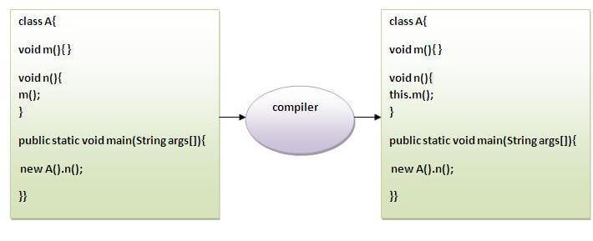

Slide 31
class A{
void m() {System.out.println("hello m");}
void n(){
System.out.println("hello n");
this.m();
}
}
class TestThis4{
public static void main(String args[]){
A a=new A();
a.n();
}}
Output:
hello n
hello m

Slide 32
this() : to invoke current class constructor
this() constructor call can be used to invoke the current class constructor.
Used to reuse the constructor
In other words, it is used for constructor chaining.

Slide 33
Calling default constructor from parameterized constructor:
class A{
A(){System.out.println("hello a");}
A(int x){
this();
System.out.println(x);
}
}
class TestThis5{
public static void main(String args[]){
A a=new A(10);
}}
Output:
hello a
10

Slide 34
Calling parameterized constructor from default constructor:
class A{
A(){
this(5);
System.out.println("hello a");
}
A(int x){
System.out.println(x);
}
}
class TestThis6{
public static void main(String args[]){
A a=new A();
}
Output:
5
hello a

